Slide 1
SMIF Update
OMG March 2017

Slide 2
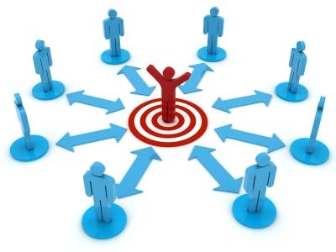
Systems as the bullseye
The focus of our current methods, funding and standards has been the definition, development, security, deployment and operation of systems.
Scope, requirements and success are all with respect to the system.
Vocabulary, concepts, data, processes and behavior are all with respect to the system.
The system is designed.
The system is secured
Such systems are, of course, crucially important – but not the only concern

Slide 3

Our reality today is thousands of systems, interdependent
The problem is less building systems, it is the interoperability and interdependence of systems
Of data
Of processes
Of missions
The methods, processes and standards developed for system building, are not serving us well for this new reality.
But the information, processes and content in “other systems” are critical for each systems mission.
Our new reality is the white space between systems – how they work together
Examples: FIBO, Threat/Risk
Welcome to the white space

Slide 4
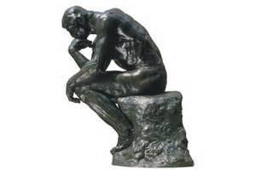
Transition of concerns
How do I build information systems?
How do federate systems and their information for multiple missions?

Slide 5
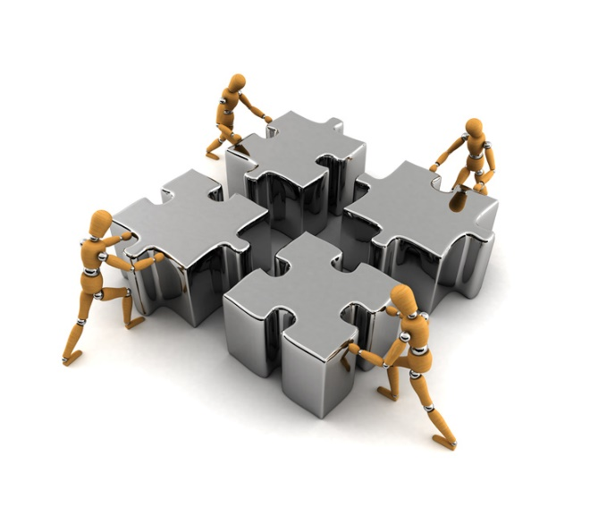
Life in the white space
There are many missions
There are many sets of requirements
There are many viewpoints
There are many vocabularies
There are many technologies
There are many standards
There is no one theory
There is no one design
There is no one authority
Yet, these systems can and must work together. They are dealing with different aspects of the same people, places, things and social constructs.
Often divergent and sometimes conflicting

Slide 6

Is the white space a system?
The methods developed for producing a system provide important capabilities, but also weaknesses when applied to the white space.
Treating the white space as a rigid system becomes fragile, limited and complex
Examples include NIEM, STIX and HL7
But we keep trying

Slide 7
Problems in the white space
Over commitment
Systems techniques applied to the white space tend to over-commit to:
Specific mission or application needs
Specific participants in a community or sub-communities
Specific Terminology
Specific Data structures
Specific Processes
Computational or ontological languages
Implementation Technologies
There will never be “agreement” on one way – our focus must be federation

Slide 8
Symptoms of over-commitment
Point-point solutions
Huge, fragile or skinny and meaningless schema
High overhead and risk for each new system integrated
Anti-agility caused by multiple point-point integrations
Inconsistency in language and interpretation of data
Re-discovery and design of well understood concepts and processes
Complex application-specific rules and restrictions in specifications
Mission specific terms in cross mission specifications
Excessive integration time and costs
Failure of joint operations

Slide 9
Proposition of Semantic Modeling for Information Federation (SMIF)
The “glue” that will bind these diverse missions, applications and data can only be our shared concepts of our shared reality.
Concepts of people, places, things, processes and social constructs
Only these concepts can be the pivot point between these divergent systems with different missions, viewpoints, technologies, schema and application requirements.
These concepts are captured in a conceptual reference model.
The representation of these concepts must not over-commit, but be shared across the potential domains and systems at a level of sufficient agreement and formality for mutual understanding
The same concepts will be formalized in different ways, sometimes seeming incompatible. Formalization and conceptualization are not the same.

Slide 10
Pivoting Through a Reference Model
“Source”
Data
Representation
Data representations (Schema & Instances)
Model data for a purpose using a technology
“Instances” are data structures (e.g. SQL tables or XML documents) – “facts” about the things in the world from some perspective
Conceptual Reference Models
A conception of the world by a group of stakeholders – less purpose specific
“Instances” are things in the world – so can’t be in models
Using abstraction, we can have multiple representations of facts about the world in different data structures and technologies
Rules define how domain concepts can be represented in a particular form – rules can be simple and generic or heavyweight and specific, depending on the representation.
“Target”
Data
Representation
Represent
Rules
Conceptual Domain Models
(Models of the world)

Slide 11
Essential Components
Libraries of shared concepts
(A “lattice of theories”, connected & precise but not monolithic or over-committed)
E.g. Threat/risk concept library & Conceptual FIBO
Capabilities - implementation frameworks able to support, interpret and leverage the models
Conceptual modeling language - sufficient to represent these concepts for both stakeholder engagement and automated processing.
E.g. SMIF Language
Mapping language – able to express how specific data structure patterns represent specific conceptual patterns. E.g. SMIF Mapping language
Mappings to standard, proprietary and internal data structures.
E.g. Threat/risk mappings to STIX & NIEM

Slide 12
Enabled Capabilities
Capability – Synthesis
Ingest and interpret information and processes from multiple divergent sources
Situational awareness
Federated analytics “Connecting the dots”
Joint missions and desperate industries
Capability – Information Brokerage
Translate information between diverse sources and consumers
Capability – Design for interoperability
Instead of designing “from scratch”, use conceptual models as the foundation for new systems. This reduces cost and errors while building in interoperability. Leverages MDA model execution.

Slide 13
SMIF Status
What we have
What we lack
Draft specification
Conceptual and MOF model of conceptual and mapping language
Concrete notation as a UML profile
Refences to formal definitions in external sources
Informal mapping to OWL
Evolving implementation of the UML profile and OWL mapping (CCM)
Usage in FIBO and OTR
Implementation of the mapping capability
Formalization of the conceptualizations
Fully specified OWL mapping
Sufficient industry engagement & funding
Recent changes
Overall tightening and consistency
Better external references including fUML & BFO
Implementable MOF model for transformations

Slide 14
Example of formalization references
Entity Type
A type of an identifiable entity. All concrete entity instances must have at least one entity type. Entity type may be mixed with other types to fully define an entity.
[FUML] Classifier
[Guarino1994] Substantial or Pseudo-Sortal (Substantial being concrete)
[Guizzardi] A Rigid Universal. (Rigid Universal): A universal G is rigid (or modally constant) iff for any w,w ∈ W 3. extw(G) = extw(G) Putting definitions 4.1 and 4.3 together, we have that for any rigid universal G the following is true 4. ext(G) = extw(G), for all w ∈ W A rigid universal is one that applies to its instances necessarily, i.e., in every possible world. Every substance sortal G is a rigid universal.
[OWL] rdfs:Class (as Entity Type does not include values). However, non-primitive values are typically represented as rdfs:Class

Slide 15
Approach to further formalization
Quandary: How to formalize without over-commitment?
Direction: Formalization will be via mapping, bootstrapped in OMG QVT-O
OWL
Rule-ML
This is in-progress, with implementation being done in EMF using QVT. Models are produced using Nomagic Cameo Concept Modeler.
The mappings will make more explicit the current references.

Slide 16
Important Conceptual Modeling Concepts
Relationships
First-class nary relationships
Restriction of relationships and properties
4d Capable situations and relationships
Roles and phases
Values and units (vs identifiable types)
Unions, intersections and disjointness
Patterns
Context and HOL
“Open world”

Slide 17
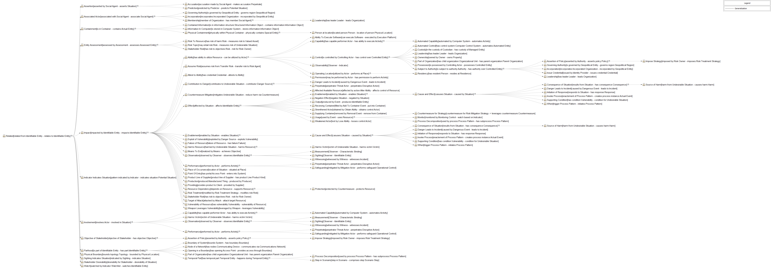
Relationship Hierarchy

Slide 18
Relationship Hierarchy

Slide 19
Applying SMIF to Operational Threats & Risks

Slide 20
Standards to capabilities
What may capabilities based on OTR look like?

Slide 21
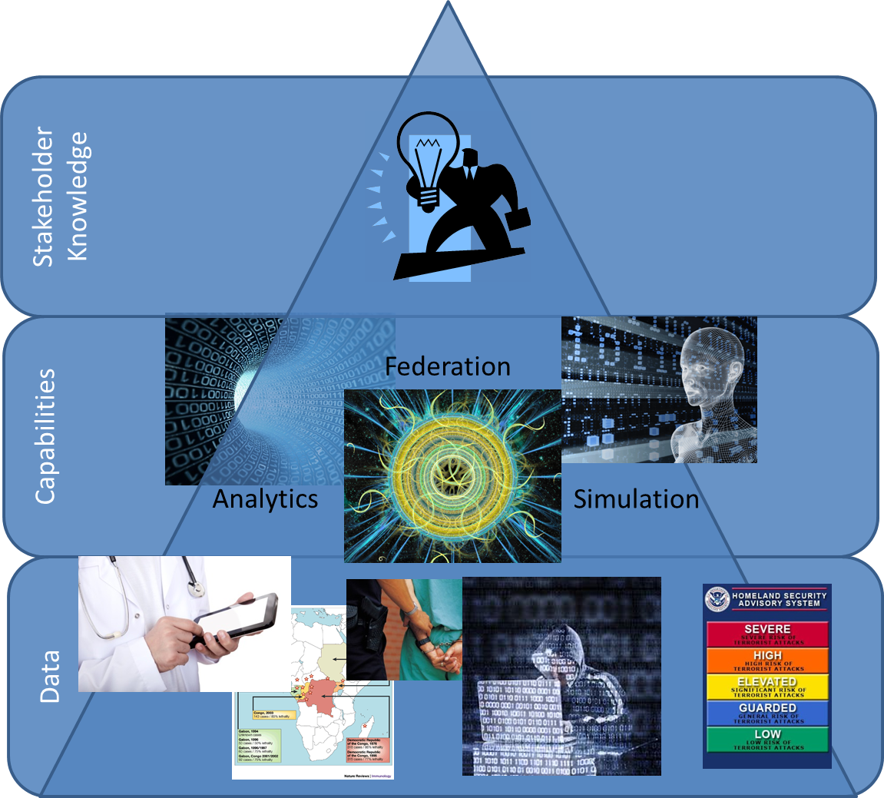
Data to Intelligence
Stakeholder Intelligence

Slide 22
Primary Use Cases
Data Format 1
Data Format 3
Threat / Risk
Data Broker
Data Format 2
Data Format 4
Data Format 2
Data Format 3
Data Format 1
Data Format 4
Threat / Risk
Federation / Analytics
New Knowledge

Slide 23


Federation Engine
Federated repository of facts from all sources
Read and write data in a variety of formats and map the data into a data graph repository based on the conceptual models
Federate data from multiple sources such that new facts can be determined though matching entities and advanced analytics
Apply rules to infer new information and map information

Slide 24

Example Gateway
Information
Provider
Provider’s Gateway
Trusted Space
Web Browser
Gatelet
Application
Interface
API
Gatelet
Federation
Engine
Online User
Inerpol
Gatelet
GANG Data
Workflow
others
SQL DBMS
SQL
Gatelet
Rules
NIEM/Global
Gatelet
GANG IEPD
Port
Models
GANG
Data Exchange
Consumer’s Gateway
Consumer
System
Trusted Space
Federation
Engine
NIEM/Global
Gatelet
GANG IEPD
Port
Criminal Data
CSV File
Exchange
CSV
Gatelet
Workflow
Rules
NLET IEPD
Port
others
Models

Slide 25
Technologies to leverage
Semantic information mapping and integration is core
Library of concepts
Mapping technologies
Enhanced graph DB
Rule based
For brokering
Secure endpoint “plugins” for multiple protocols
STIX/TAXII, NIEM/GRA, HL7, Etc
Must be hardened and adaptable
Leverages and uses Analytics Engines
Primarily a “read only” from multiple sources
Requires entity extraction
Need analytics & Visualization engines: Buy/Partner /Build
Capabilities “plug in”
Combination of open source and proprietary

Slide 26

It takes a community!
http://www.ThreatRisk.org
Threat & Risk Information
Sharing Community
Leadership
Information
Sources
Policy
Standards
Tools &
Services
Information Analysts
& Consumers

